Slide 1
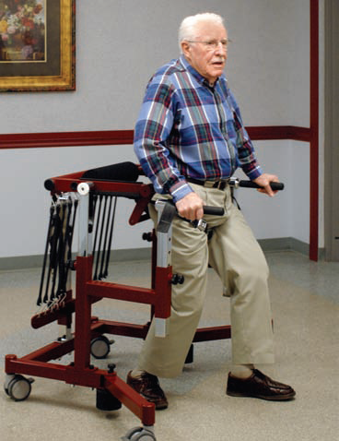
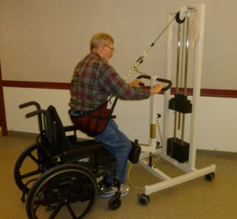
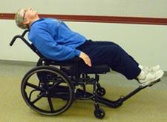
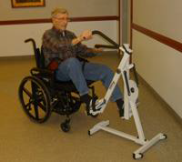
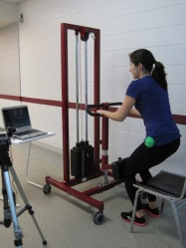
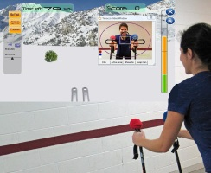
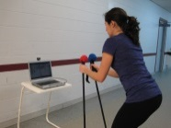
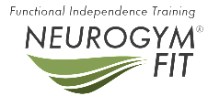
Intensive Mobility Training with Enabling Technology Reduces Stay Days in Convalescent Care
Eric Heiden MSc.
NeuroGym FIT
neurogymfit@gmail.com
Avi Nativ PT PhD.
NeuroGym Technologies
avi@neurogymtech.com
Purpose
Research in brain plasticity and motor learning suggests that enabled movement training can lead to improved rehabilitation outcomes. Intensive mobility training with enabling technology may improve outcomes and reduce stay days in convalescent care.
Relevance
Enabled movement training is a promising means to improve strength, endurance, balance and functional mobility. Intensive mobility training with enabled movement technology can help convalescent care patients to return to functional mobility sooner and ensure patients are discharged into the community safely.
Methods and Analysis
Methodology and equipment for enabled movement training was established at Hawthorne Place Care Centre’s 28-bed Convalescent Care program. 42 patients received enabled movement training over a period of four months. Patients in this group were evaluated using the Elderly Mobility scale and Tinetti Balance Test. A retrospective sample of 28 patients who passed through the same Convalescent Care Program in the previous four months was used for comparison. The two groups were compared for average length of stay and discharge location.
Findings
Patients receiving enabled movement training improved or maintained their functional measures (90% of patients showed improvement, 10% maintained). The average length of stay for patients receiving enabled movement training was 55 days, compared to 77 days for the patients who did not receive enabled movement training.
Discussion
Enabled movement technology, including progressive sit to stand training, body weight supported gait and balance training, and computerized biofeedback training have been shown independently to improve rehabilitation outcomes. An intensive mobility training program utilizing these tools in a Convalescent Care environment leads to improved mobility outcomes and a shorter length of stay.
Conclusions
Implementing an intensive program of mobility training with enabling technology can reduce the length of stay in Convalescent Care programs with a very high rate of improvement in functional mobility.
References
Boyne P, Israel S, Dunning K. (2011). Speed-dependent body weight supported sit-to-stand training in chronic stroke: a case series. Journal of Neurologic Physiotherapy, 35, 178-184.
Britton, E., Turton, A. (2008). An exploratory randomized controlled trial of assisted practice for improving sit-to-stand in stroke patients in the hospital setting. Clinical Rehabilitation 22, 458-468.
Canadian Institute of Health Information. (2009). Alternate Level of Care in Canada. Ottawa ON.
Peri, K., Kerse, N., Robinson, E., Parsons, M., Parsons, J., & Latham, N. (2008). Does functionally based activity make a difference to health status and mobility? A randomised controlled trial in residential care facilities. Age and Ageing, 37, 57-63.
Bungee Mobility Trainer
Sit to Stand Trainer
Exercise Wheelchair
Pendulum Stepper
NeuroGym Tim Trainer Biofeedback System

